Slide 2
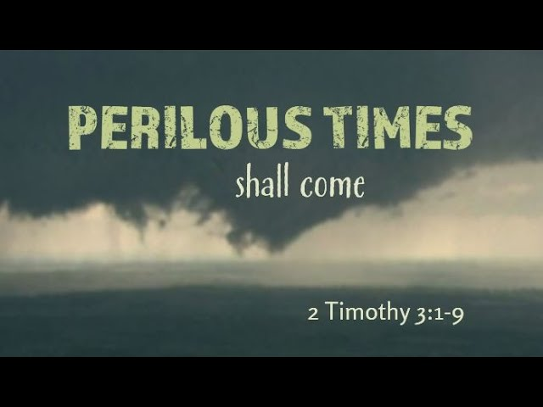

Slide 3

“PERILIOUS TIMES”
2 Timothy 2:26 “snare of the devil, having been taken captive by him to do his will.”
“Perilous” used twice in the New Testament
“dangerous, or (by implication) furious” “hard to bear, painful”
“It describes a terrible period of evil – difficult and troublesome times for God’s people.”

Slide 4

A TIME OF PERSECUTION
2 Timothy 3:10-12 “all who desire to live godly in Christ Jesus will suffer persecution.”
2 Timothy 1:8; 4:6 “I am already being poured out as a drink offering, and the time of my departure is at hand.”
In 1 Timothy 3:14,15 Paul looks forward to coming to Timothy
Here he looks forward to Timothy coming to him – 2 Timothy 1:4; 4:9,21

Slide 5

A TIME OF INCREASING APOSTASY
2 Timothy 2:16-18; 3:2-7,13;4:3,4
W. R. Jones “Preaching Christ in the 20th century—it must be relevant preaching. It must deal with the needs of those who hear, and application must be made if any good is to be accomplished. To put it in a rather crude country saying, “You have to put the salve where the sore is.” Preaching must address itself to man’s real problem: sin and rebellion against God.”

Slide 6
NOT THE WORST THAT HAS EVER BEEN
Socrates by Plato {cir. 400 B.C.} “The children now love luxury; they have bad manners, contempt for authority; they show disrespect for elders and love chatter in place of exercise. Children are now tyrants, not the servants of their households. They no longer rise when elders enter the room. They contradict their parents, chatter before company, gobble up dainties at the table, cross their legs, and tyrannize their teachers."

Slide 7
NOT THE WORST THAT HAS EVER BEEN
Isaac Asimov’s Book of Facts (1979) “an Assyrian clay tablet dating to approximately 2800 BC was unearthed bearing the words "Our earth is degenerate in these latter days. There are signs that the world is speedily coming to an end. Bribery and corruption are common."
Ecclesiastes 1:9 “nothing new under the sun.”

Slide 8
SEVERAL OF PAUL’S ASSOCIATES FELL AWAY
2 Timothy 1:15; 4:10,16 “Demas has forsaken me, having loved this present world”
2 Timothy 1:6-8 “stir up the gift of God which is in you through the laying on of my hands.7 For God has not given us a spirit of fear, but of power and of love and of a sound mind. 8 Therefore do not be ashamed of the testimony of our Lord, …share with me in the sufferings for the gospel according to the power of God.”

Slide 9
PAUL’S EXHORTATIONS TO TIMOTHY
Fulfill Your Ministry – 2 Timothy 4:2,5 “Preach the word! Be ready in season and out of season. Convince, rebuke, exhort, with all longsuffering and teaching…do the work of an evangelist, fulfill your ministry.”
Endure The Hardships That Now Attend It – 2 Timothy 1:8; 2:3,4-6

Slide 10
PAUL’S EXHORTATIONS TO TIMOTHY
Continue In What He Had Learned – 2 Timothy 3:14 “knowing from whom you have learned them.”
Flee The Youthful Lusts – 2 Timothy 2:22 “pursue righteousness”
Look To Paul As An Example of Faithfulness – 2 Timothy 1:11-13; 3:10,11; 4:7

Slide 11
WHAT APPLICATION CAN WE MAKE?
Train More Teachers – 2 Timothy 2:1,2
Try To Regain Those Who Have Gone Astray – 2 Timothy 2:24-26; 3:13; 2:16,23
Preaching The Word And Correcting Them With Gentleness- 2 Timothy 2:24,25; 4:2 “in humility correcting those who are in opposition”

Slide 12
WHAT APPLICATION CAN WE MAKE?
Remember The Lord Jesus Christ – 2 Timothy 2:8
2 Timothy 2:19 “solid foundation of God stands”
2 Timothy 2:11-13; 4:7,8 “I have kept the faith. 8.., there is laid up for me the crown of righteousness, which the Lord, the righteous Judge, will give to me on that Day, … also to all who have loved His appearing.”

